Slide 1
CCS
Customer Churn Prediction System

Slide 2

Background
Our marketing department relies on churn prediction system to prioritize resource allocation, i.e., exclude customers not expected to churn from marketing campaigns
Marketing department makes effective use of customer churn probabilities to prioritize communication with customers expected to cancel contract with high probability.
Predicted probabilities are also used to determine marketing offers and to select appropriate communication channels in each case.

Slide 3
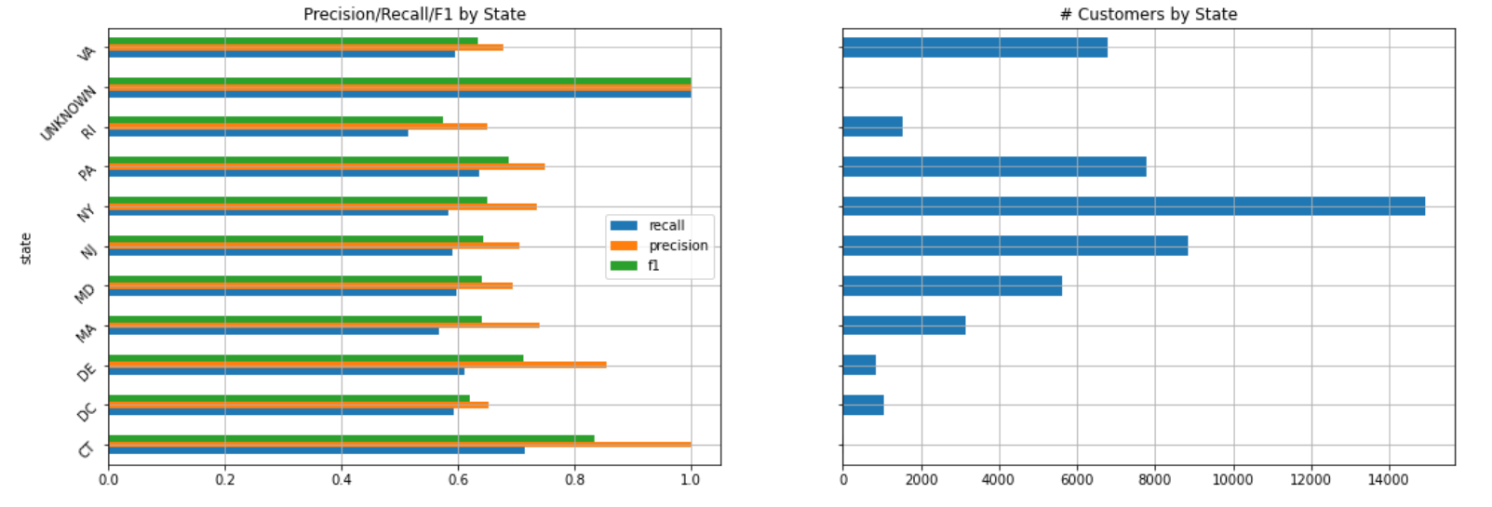
Error Analysis
A breakdown of performance by state is as follows:

Slide 4
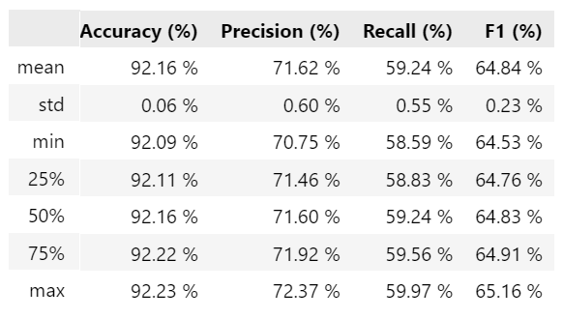
Expectations
Our expectations from a new model is:
* Increased recall while keeping precision at the same level (or vice versa)
Current Status
Performance metrics for the current model in use are as shown below:

